Slide 1

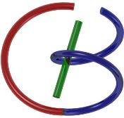
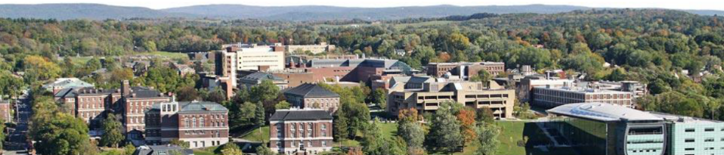
38655 BMED-2300-02
Lecture 19: MRI Imaging
Ge Wang, PhD
Biomedical Imaging Center
CBIS/BME, RPI
wangg6@rpi.edu
April 6, 2018

Slide 2
BB Schedule for S18
Tue | Topic | Fri | Topic
1/16 | Introduction | 1/19 | MatLab I (Basics)
1/23 | System | 1/26 | Convolution
1/30 | Fourier Series | 2/02 | Fourier Transform
2/06 | Signal Processing | 2/09 | Discrete FT & FFT
2/13 | MatLab II (Homework) | 2/16 | Network
2/20 | No Class | 2/23 | Exam I
2/27 | Quality & Performance | 3/02 | X-ray & Radiography
3/06 | CT Reconstruction | 3/09 | CT Scanner
3/20 | MatLab III (CT) | 3/23 | Nuclear Physics
3/27 | PET & SPECT | 3/30 | MRI I
4/03 | Exam II | 4/06 | MRI II
4/10 | MRI III | 4/13 | Ultrasound I
4/17 | Ultrasound II | 4/20 | Optical Imaging
4/24 | Machine Learning | 4/27 | Exam III
Office Hour: Ge Tue & Fri 3-4 @ CBIS 3209 | wangg6@rpi.edu
Kathleen Mon 4-5 & Thurs 4-5 @ JEC 7045 | chens18@rpi.edu

Slide 3
MRI Imaging
Revisit
How to Model T1 & T2
How to Measure T1 & T2
Slice Selection
Gradient Field Along One Axis
Slice Thickness & Re-phasing
Sampling in the k-Space
Phase Encoding
Frequency Encoding
k-Theorem
MRI Scanners

Slide 4

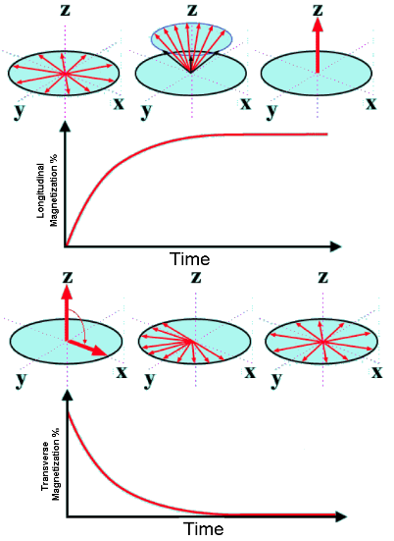
T1 & T2 Relaxation
T1: Recovery
Recovery of M along the z-Axis
T1 Time Defined as 63% Recovery of M₀
Spin-Lattice interaction
T2: Dephasing
Loss of M in the x-y Plane
T2 Time as 37% Loss of M₀
Spin-spin Interaction

Slide 5
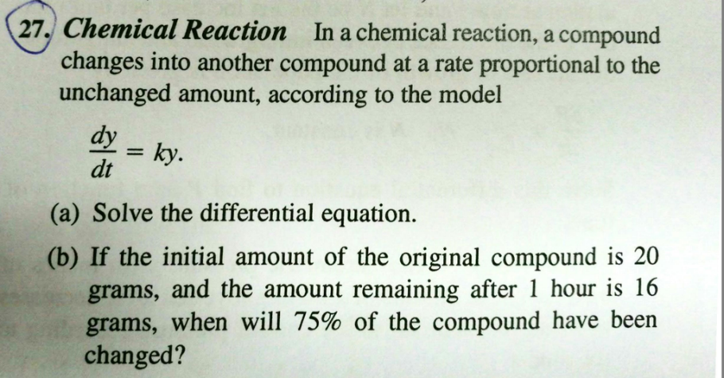

Rate Proportional to Amount

Slide 6
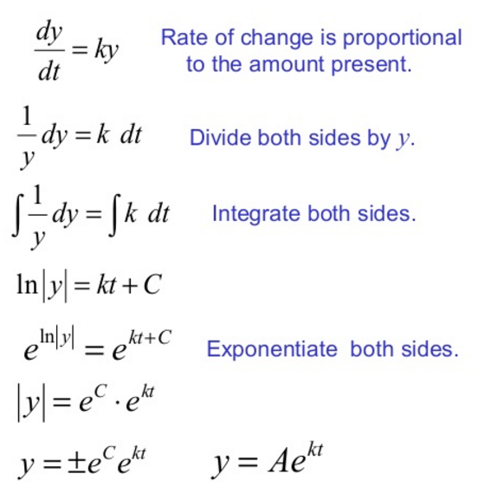
Mathematical Steps

Slide 7
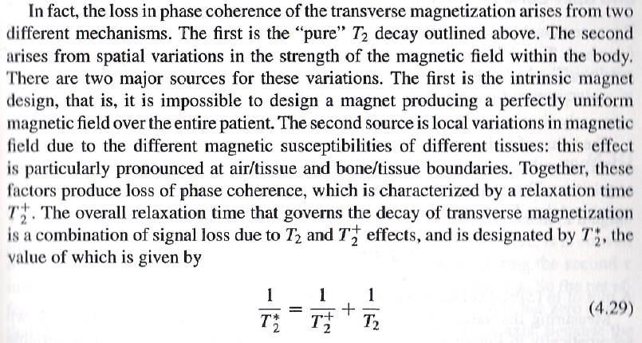
T₂, T₂⁺ & T₂*
Constant Inhomogeneous Magnetic Field
Spin-spin interaction, Time-varying Inhomogeneous Magnetic Field

Slide 8
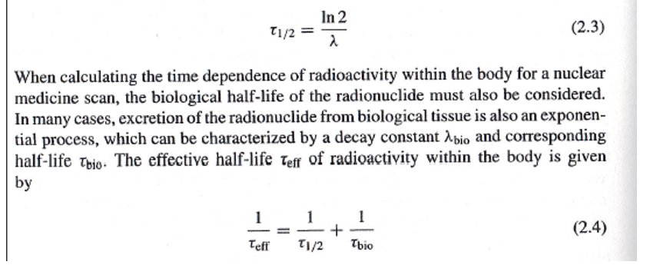
Mathematical Details
Let Us Compare with What We Learned on Nuclear Tomography, and Note the Common Reciprocal Relationship for Time Constants
Inherent Decay of Physical or Chemical Nature
Biological Decay on top of the physical Decay (Decay Rates Are Additive)

Slide 9
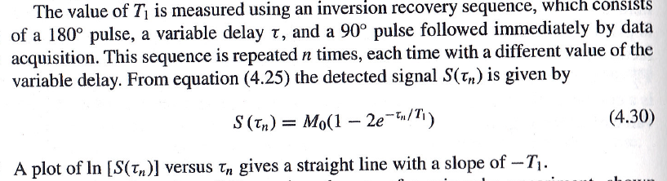
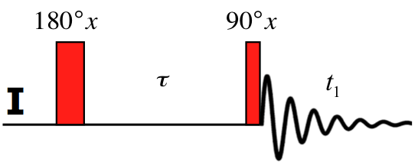
T1: Inversion Recovery
(Note: S(0)=- M₀)

Slide 10

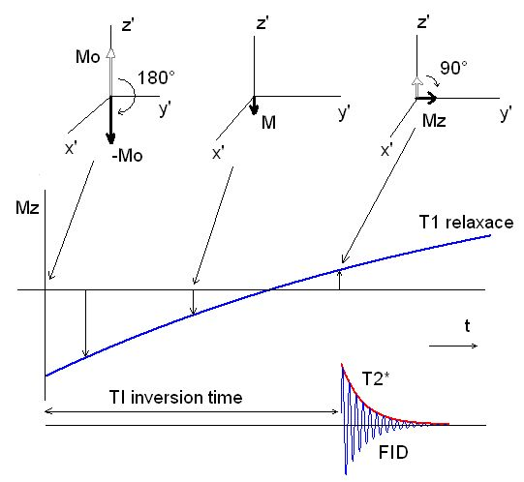
Visualize it!

Slide 11
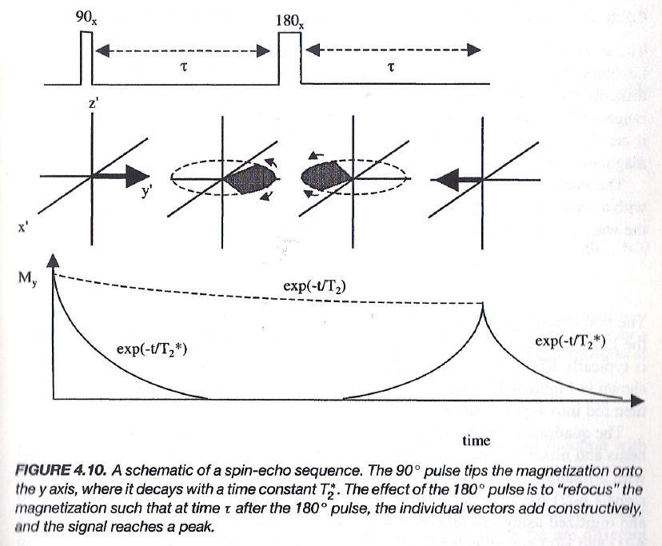
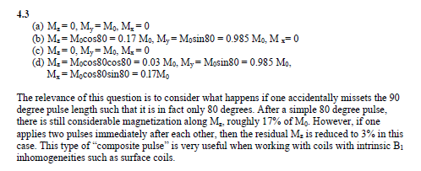
T2: Spin-Echo

Slide 12
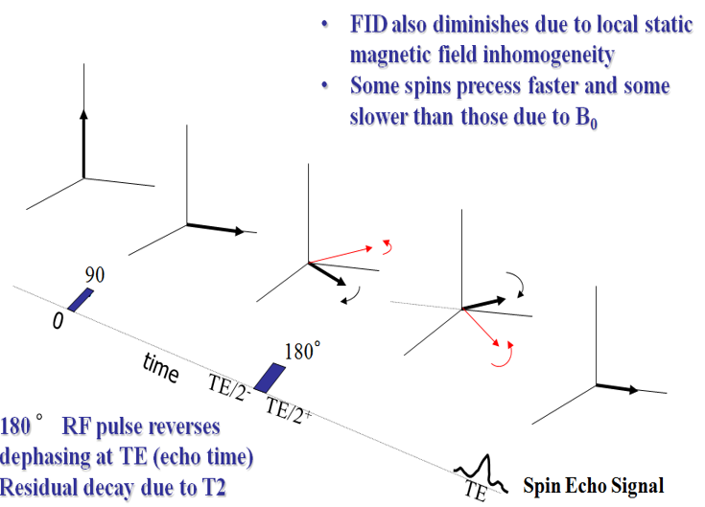
Another Trick for Spin Echo

Slide 13

Simple Idea Behind Spin Echo
Starting Point
Different Mileage
New Alignment
Direction Change

Slide 14
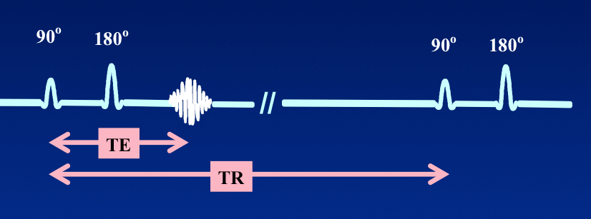
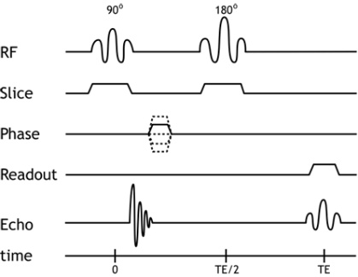
TE & TR Parameters

Slide 15
MRI Imaging
Revisit
How to Model T1 & T2
How to Measure T1 & T2
Slice Selection
Gradient Field Along One Axis
Slice Thickness & Re-phasing
Sampling in the k-Space
Phase Encoding
Frequency Encoding
k-Theorem
MRI Scanners

Slide 16
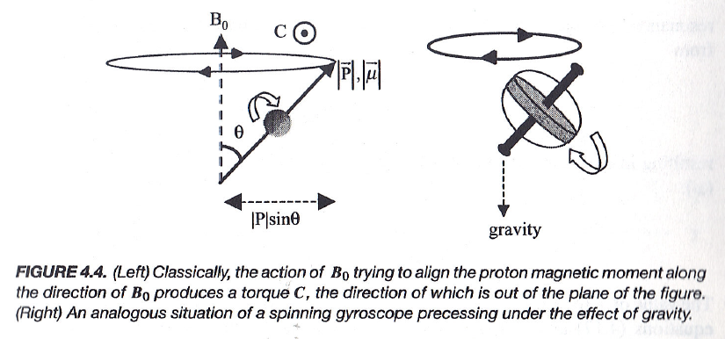
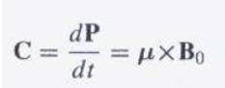
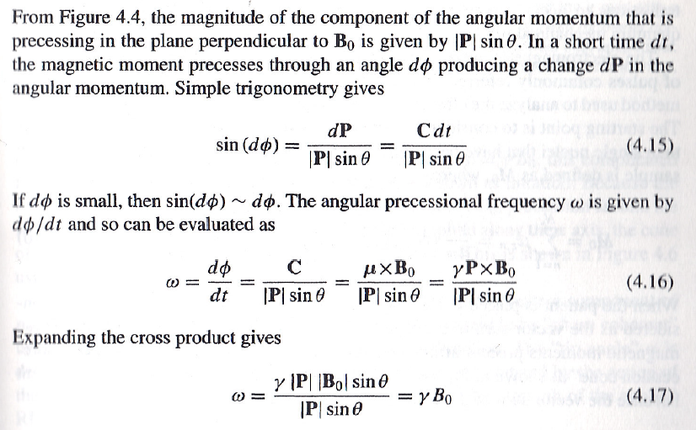
Processional Frequency on B
P: Angular Moment
μ: Magnetic Moment

Slide 17
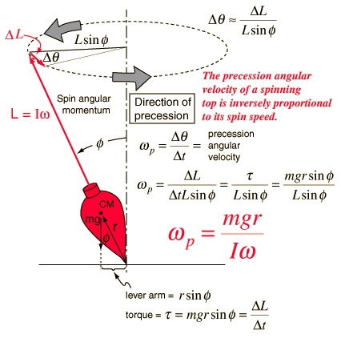
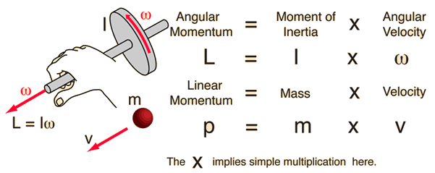
If You Want to Exercise More

Slide 18
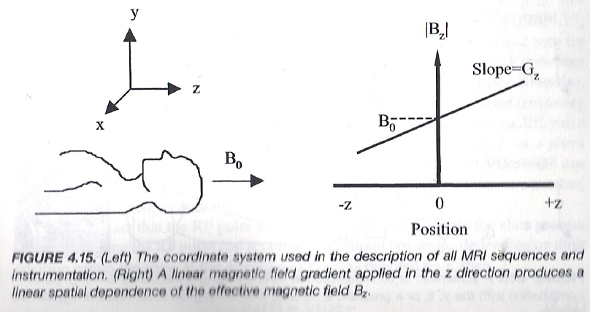
Field Gradient

Slide 19
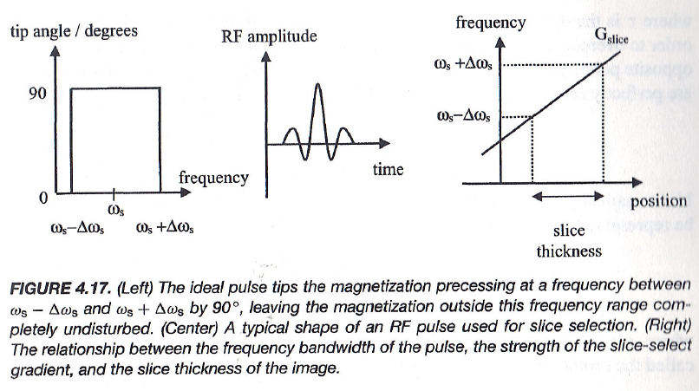
Slice Thickness

Slide 20
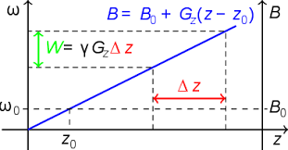
Slice Thickness

Slide 21
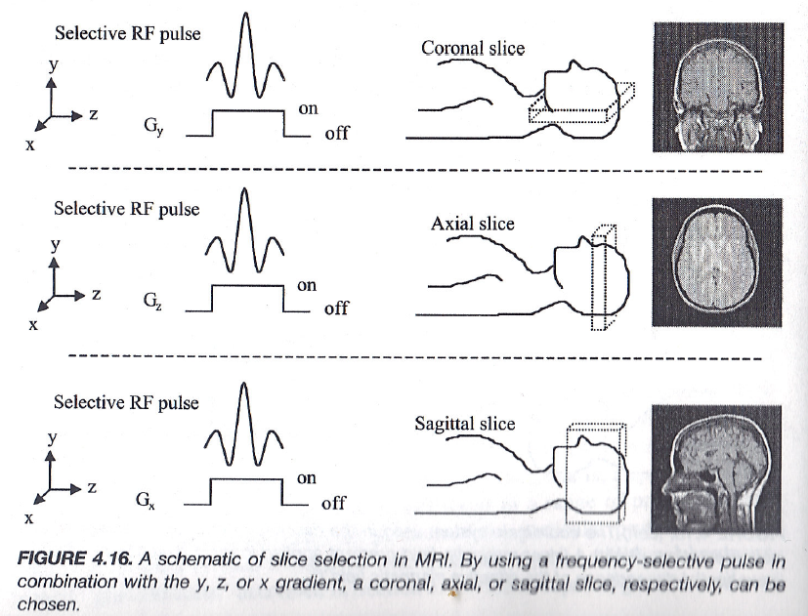
Slice Selection

Slide 22
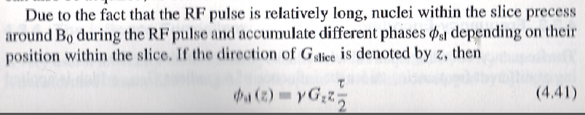
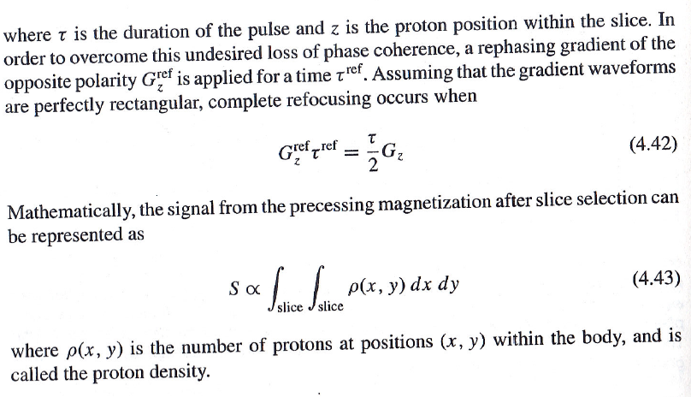
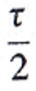

Re-phasing Gradient

Slide 23
MRI Imaging
Revisit
How to Model T1 & T2
How to Measure T1 & T2
Slice Selection
Gradient Field Along One Axis
Slice Thickness & Re-phasing
Sampling in the k-Space
Phase Encoding
Frequency Encoding
k-Theorem
MRI Scanners

Slide 24
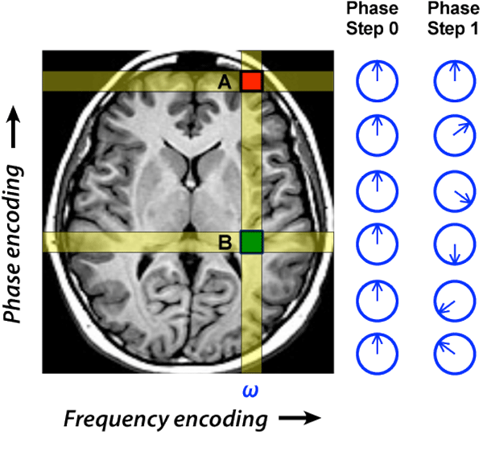
Phase Encoding

Slide 25
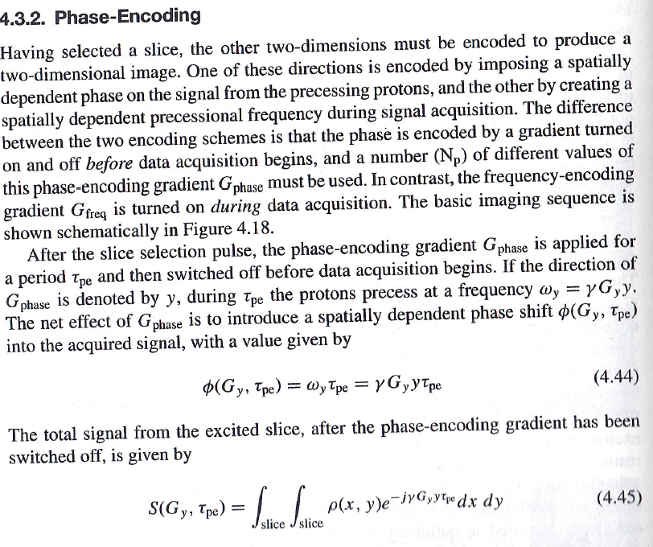


Slide 26
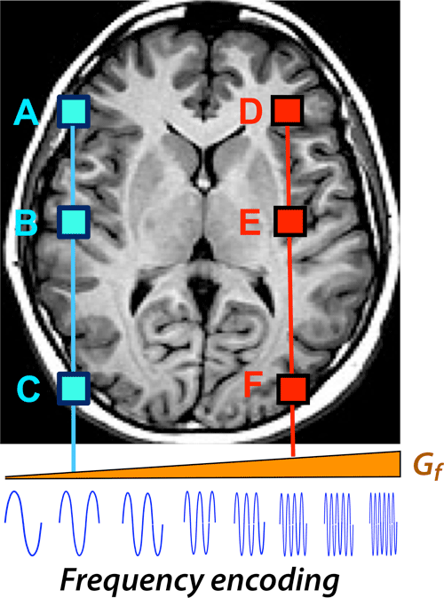
Frequency Encoding

Slide 27
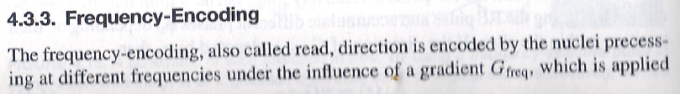
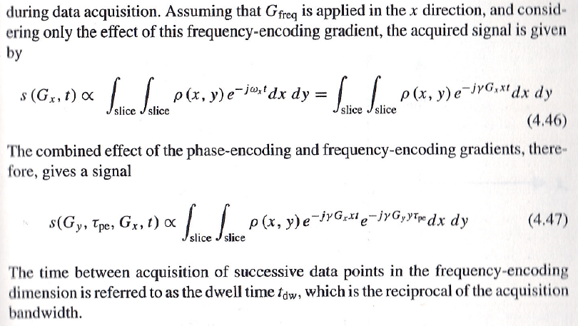

Slide 28
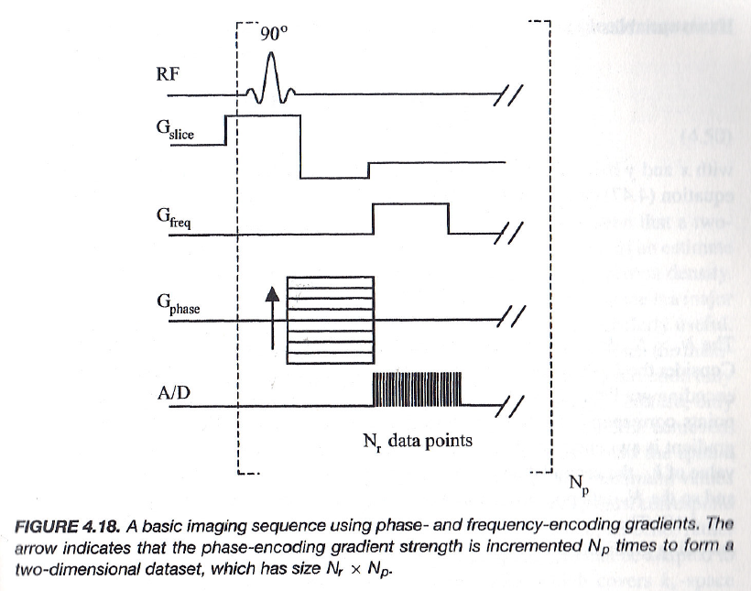
Phase & Frequency Encoding

Slide 29
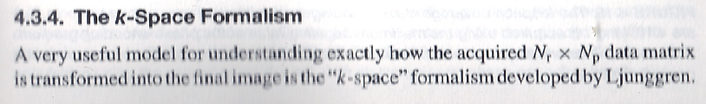
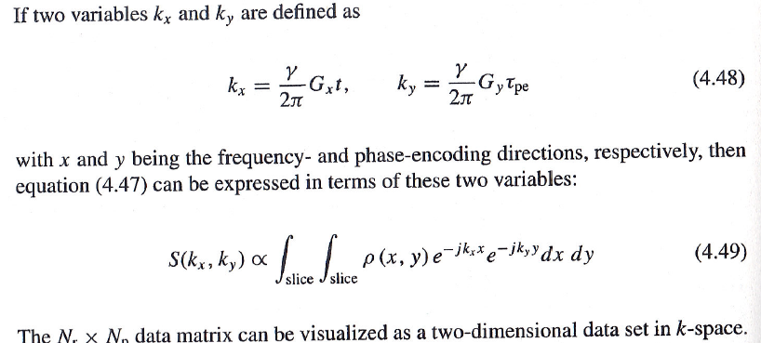
Fourier Imaging

Slide 30
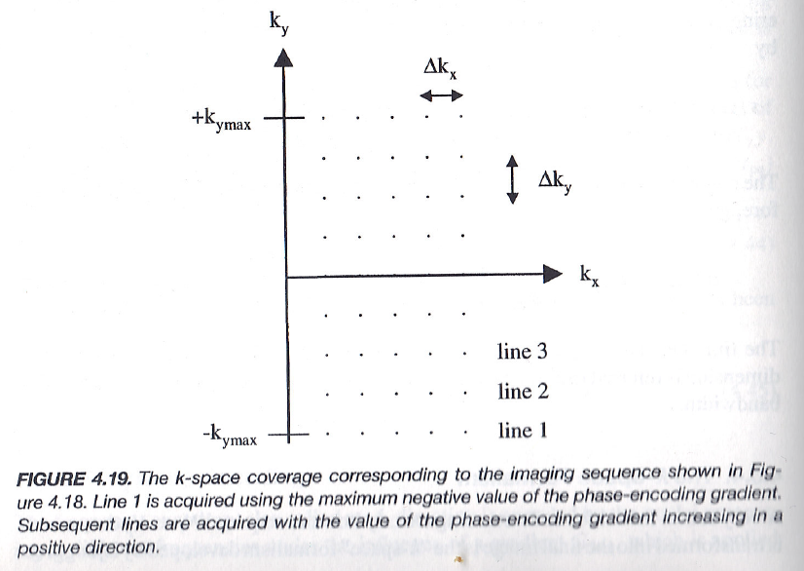
Data in the k-Space

Slide 31
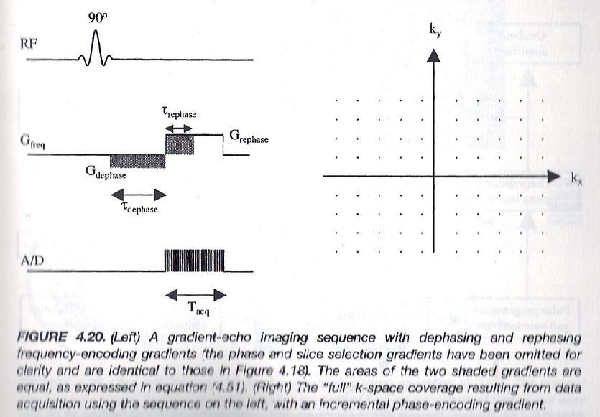
Full Coverage in the k-Space

Slide 32
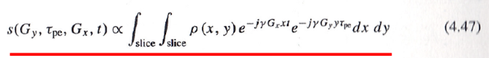
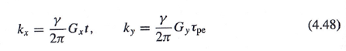
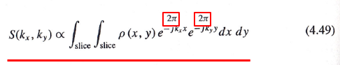
Phase & Frequency Encoding (τ->t)
γG_{x} t/2π, γ G_{y} τ_{pe}/2π
γG_{x} t/2π, γ G_{y} t/2π
γG_{x} τ_{pe_x}/2π, γ G_{y} τ_{pe_y}/2π
γG_{x} τ_{pe_x}/2π, γ G_{y} t/2π

Slide 33



Understood? Or Confused?
Let Me Explain Again,
With More Details

Slide 34
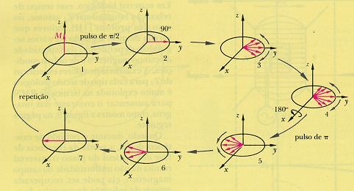
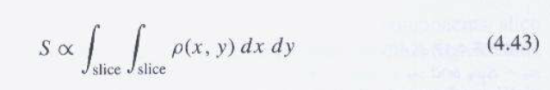
Another Illustration of Spin Echo
This is a highly simplified signal model.
http://www.intechopen.com/source/html/43522/media/image3.png

Slide 35
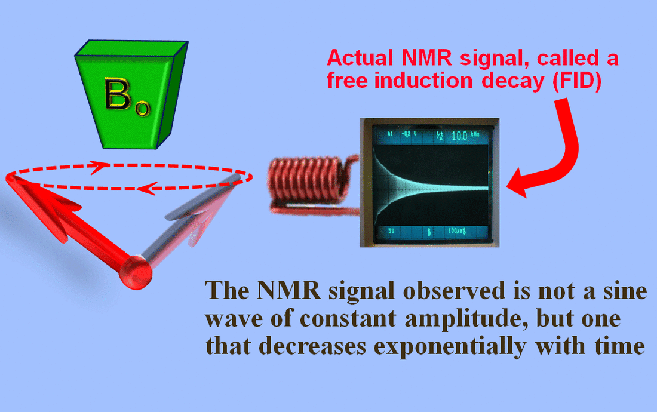
FID Signal

Slide 36
TE & TR Parameters

Slide 37
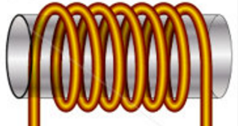
Signal Model for a 90˚ Pulse
Rotating Transverse Component of M Induces a Current in Quadrature Coils
In the Rotating Frame:
Repeated after TR:
Total Signal:
z
s_{y}(t)
M
y’
x’
s_{x}(t)
Determined by
Proton Density ρ, T₁, & T₂ (Biological)
B₀, TR, TE, & t (Technical)

Slide 38
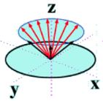
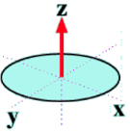
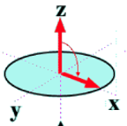
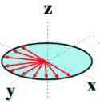
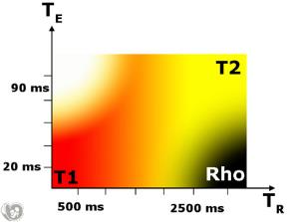
ρ-, T₁- & T₂-weighting Illustrated
Key Points to Understand:
Long TR: M Fully Recovered so No T₁ Effect
Short TE: M_{xy} Has Little Time to De-phase so No T₂ Effect
Short TR
Long TR
Short TE
Long TE
Short TR (Short TE): T1-weighted
Long TE (Long TR): T2-weighted
Long TR & Short TE: ρ-weighted

Slide 39

Example: Brain Images
White
CSF
Grey
Ρ Weighted T2 Weighted T1 Weighted
Tissue Type | T1(s) | T2(s)
Grey Matter | 1.0 | 0.10
White Matter | 0.7 | 0.08
Cerebrospinal Fluid (CSF) | 2.0 | 0.25
Blood | 1.2 | 0.25
Water | 4.7 | 3.50

Slide 40
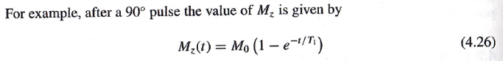
Special Case of G_{x} Encoding
Linear Gradient G_{x} along the x Axis
Precession Frequency Depends on Coordinate x:
G_{x}
Local Proton Density
Partial Recovery
Due to T1
Decay Due to
T2
TE
t
Amplitude of Local Signal
Frequency of Local Signal

Slide 41
For k-Space Data
k_{y}
s(t)
k_{x}

Slide 42
Then, the General Case
G (or k) Varies, Whose Effect (Upon the Procession State) Is Accumulative w.r.t. Time.
Furthermore, the Linear Gradient Field Leads to the Inner Product Form
k_{z}
s(t)
k-Space Theorem
k_{y}
k_{x}

Slide 43

Three Approximations
T2* Decay
Negligible Relative to T2* Decay (& T1 Decay)
Readout Time
Negligible Relative to T2 Decay (& T1 Decay)
Spin Motion Negligible Relative to Spatial Resolution
k_{z}
s(t)
k-Space Theorem
k_{y}
k_{x}

Slide 44


MRI Example
k_{y}
y
s(t) = F(k_{x},k_{y})
f(x,y)
k_{x}
x
k-space
Modulus of F(k_{x},k_{y}) Inverse FT of F(k_{x},k_{y})

Slide 45
MRI Imaging
Revisit
How to Model T1 & T2
How to Measure T1 & T2
Slice Selection
Gradient Field Along One Axis
Slice Thickness & Re-phasing
Sampling in the k-Space
Phase Encoding
Frequency Encoding
k-Theorem
MRI Scanners

Slide 46

MRI System Diagram

Slide 47

3D Rendering

Slide 48

MRI Scanner
Sparkler 1.5T MRI Made by Philips & Neusoft Joint Venture in 2008

Slide 49



PET-MRI Scanner

Slide 50


Preclinical MRI Scanner
Bruker BioSpec Avance III 94/20 9.4T Preclinical MRI Scanner

Slide 51

CT-MRI: Radiation Therapy

Slide 52

Potential Design (Xun Jia et al.)
Magnet separation ~70 cm
Couch rotation ~±25°
Ring design for mechanical stability and magnet shielding
CBCT on the ring (not shown)

Slide 53
A Few Links
Spin Echo:
https://www.youtube.com/watch?v=dFp2Z3wjrmo
https://www.youtube.com/watch?v=vMh11VtUA5o
Gradient Echo:
https://www.youtube.com/watch?v=Rvpa1gqG06g
https://www.youtube.com/watch?v=MnlG51a4sLE
Slice Selection:
https://www.youtube.com/watch?v=TS8HFHML0ac

Slide 54


BB19 Homework
Due Date: Same (1 Working Week Later)

